Slide 1
Monthly Usage and Feedback Report
February 2020

Slide 2
VAOS Usage

Slide 3
VAOS Usage By Month

Slide 4
Overall Requests and Self-Scheduling Usage
 | Dec ‘19 | Jan ‘20 | Feb ‘20 | 3-Month Total | Total Prior to Past Three Months | Overall Total
Total Sites Deployed | 139 | 139 | 139 | 139 | 139 | 139
Total Usage | 30,038 | 42,168 | 33746 | 105,952 | 457,769 | 563,721
PC Usage | 20,799 | 28,684 | 23265 | 72,748 | 359,749 | 432,497
MH Usage | 4,124 | 5,960 | 4462 | 14,546 | 67,723 | 82,269
Amputation Usage | 29 | 30 | 25 | 84 | 113 | 197
Audiology Usage | 1,313 | 1,867 | 1472 | 4,652 | 6,235 | 10,887
Clinical Pharmacy Usage | 323 | 483 | 299 | 1,105 | 1,174 | 2,279
CPAP Usage | 246 | 446 | 304 | 996 | 1,185 | 2,181
Food and Nutrition Usage | 155 | 317 | 204 | 676 | 708 | 1,384
MOVE! Usage | 105 | 195 | 141 | 441 | 525 | 966
Ophthalmology Usage | 160 | 295 | 216 | 671 | 543 | 1,214
Optometry Usage | 2,417 | 3,442 | 2955 | 8,814 | 16,417 | 25,231
Sleep Medicine Usage | 166 | 221 | 194 | 581 | 493 | 1,074
Social Work Usage | 201 | 228 | 209 | 638 | 618 | 1,256
Data pulled from VSSC Report.

Slide 5
% of Clinics Exposed for Self-Scheduling
Specialty | Stop Code | Jan ‘20 | Feb ’20
Primary Care | 322, 323, 350 | 21.3% | 21.2%
Mental Health | 502 | 3.7% | 3.8%
Amputation Services | 211 | 4.6% | 4.5%
Audiology | 203 | 8.3% | 8.2%
Clinical Pharmacy | 160/323 | 9.1% | 9.4%
CPAP Clinic | 349/116 | 5.5% | 5.6%
Food and Nutrition | 123, 124 | 9.7% | 9.7%
MOVE! | 372, 373 | 8.3% | 8.2%
Ophthalmology | 407 | 4.7% | 5.1%
Optometry | 408 | 11.7% | 11.7%
Sleep Medicine- Home Sleep Study Equipment Pickup | 143/189 | 4.1% | 4.1%
Social Work | 125/323 | 1.9% | 1.9%
Data pulled from VSSC Location Utilization Report.

Slide 6
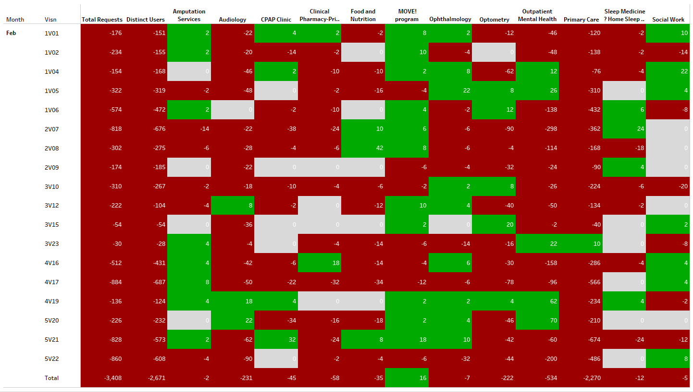
Overall Usage Since Last Month
This visual compares the amount of appointment requests at each VISN and type of care in February compared to January.

Slide 7
VAOS Quantitative Feedback Analysis

Slide 8
Overall Findings
Veterans are asked to rate VAOS and their experience using the application from 0-10.
Veterans are also asked to leave an optional comment; these responses are categorized by the Release Team as Positive, Negative or Neutral.
Average overall rating: 7.74/10
Average overall rating with a comment: 7.74/10

Slide 9
Veteran Feedback
*Encounters are a summation of Veteran VA requests, Veteran-made appointments, and Veteran-cancelled appointments

Slide 10
VAOS Feedback –Free Text Responses
The Release Team performed an in-depth analysis of the in-app feedback Veterans provided in VAOS. Free text responses were categorized as positive, negative, or neutral by the VAOS Release Team and a snapshot of those metrics is shown below.
June 2019: Stuck request and submit button fixes released
August 2019: VAOS Cancellation fix released
Note: Responses that were neutral—a status that is determined qualitatively by
the Release Team—were excluded from this analysis.

Slide 11
VAOS Qualitative Feedback Analysis

Slide 12
Qualitative Comment Analysis
The VAOS release team intakes the feedback data and goes through each comment and assigns it a sentiment score of Positive/Negative/Neutral
From there- we dig into the negative comments to bucket them into a category:
Business Process Issues
Implementation Issues
Poor User Experience
Suggested App Changes
Technical Error
Specialty Requests

Slide 13

Positive Feedback Summary
Below is a sampling of positive Veteran feedback, as well as a word cloud depicting the most common words used by Veterans in their positive feedback about VAOS. The larger the text, the most often the words were used by Veterans.
Sample Responses:
“Simple and straightforward to do.”
“VERY easy and straight forward – and I like the fact that you can ask them to call before scheduling the appointment!”
“This is so much easier than being put on hold when you call in.”
“This was extremely easy to do/use. I will definitely use again in the future!!”

Slide 14
Business Process Issues
Accountable Party | Issue Category | Definition | Number of Responses
Individual Facilities | Business Process Issue | User had a problem with VAOS that was due to the VA facility’s use of VAOS. | 15
Sample Responses:
“I attempted to schedule an appointment and it was canceled on me instead of scheduled.”
“Appointment was cancelled without my knowledge.”
“Takes too long to get a phone call back”
“I waited almost 2 weeks just to have my request cancelled. This is not convenient of faster than calling directly.”
“I need to see or speak to my medical care team today or the next business day! Not several days from now.”
“This appointment request method is not a good way of trying to set things up. Not impressed and would like to see better results. If you call me and tell me that I will be called to set up an appointment then you should CALL.”
PROPOSED SOLUTION: Add liability warning message in SM upon login
Schedulers should be warned of their responsibility to schedule a Veteran ASAP in order to decrease the amount of pending requests and improve the reliability of the application.
PROPOSED SOLUTION: Edit Feedback Form to Ask for the VAMC at which Veteran Receives Care
Provide the ability to assign a facility name to feedback so the Release Team can let VAMC Directors what problems need to be addressed or what is working well.

Slide 15
Implementation Issues
Accountable Party | Issue Category | Definition | Number of Responses
Individual Facilities | Implementation Issue | User experienced an issue with access. | 3
EXISTING BACKLOG ITEM: VATS Configuration Report: Create a formatted report
Ability for business users to pull a report of site configurations from VATS to ensure that required types of care are turned on for all sites and that sites and complying with the Reset Memo.
PROPOSED SOLUTION: Allow Veterans to request and schedule more than 90 days out
Will be addressed in the VAOS Redesign
Sample Responses:
“This appointment is too far out. I will most likely run out of medicine”
“Need to create appointment further out than the 3 months offered. Too limiting”
“Cannot schedule appointment myself”

Slide 16
Poor User Experience
Accountable Party | Issue Category | Definition | Number of Responses
Development Team | Poor User Experience | User had a bad experience using the VAOS application itself. | 47
Sample Responses:
“I feel the system does not recognize the clinic I actually go to in the city”
“I am 75yo. Not all are up to date on computers.”
“Too many steps. Redundant to have to enter email address. It would be very useful to reschedule an appointment in one step rather than cancel and request new.”
“Very slow response time. One page had to be reloaded multiple times before properly displayed.”
“A little confusing trying to schedule from my phone. Had to use a computer.”
“Difficult to navigate from one section to another. I’m trying to get back to messages or at least sign out”
“Way too slow!”
PROPOSED SOLUTION: Fewer Clicks to Schedule
Will be addressed in the VAOS Redesign
As a Veteran, I’d like to have to go through fewer pages to schedule my appointment to increase ease and efficiency compared to calling my VA facility.
PROPOSED SOLUTION: Improve Latency of App
Will be addressed in the VAOS Redesign
As a Veteran, I would like to be able to schedule an appointment faster without waiting for the page to load after each selection.

Slide 17
Suggested App Change
Accountable Party | Issue Category | Definition | Number of Responses
Development Team | Suggested App Change | User had a suggested change or new feature they wanted to see in the app. | 20
Sample Responses:
“Needs to show address location on map!”
“Please make comment section to scheduler to allow more than 100 characters of text.”
“Needs a choice for missing appointments due to illness and other medical conditions.”
“The prior way of secure messaging to schedule my appt's was a lot better and easier to manage.”
PROPOSED SOLUTION: Add more characters to the comment/explanation box for Veteran to explain need for appointment.
Will be addressed in the VAOS Redesign
EXISTING BACKLOG ITEM: Reschedule an appointment
Veterans need the option to reschedule an appointment instead of cancelling and scheduling a brand new appointment to cut down on time spent as well as the hassle of re-entering
PROPOSED SOLUTION: Add more options for cancelling a request or appointment.

Slide 18
Technical Error
Accountable Party | Issue Category | Definition | Number of Responses
Development Team | Technical Error | User experienced a technical issue or error message while using the VAOS app. | 20
Sample Responses:
“Doesn't let me cancel appointments”
“I am trying to setup an appointment with my local VA clinic but the only option it gives me to go to is Boston”
“When you ask your computer to add to may calendar it does not work.
“I have the wrong provider listed”
PROPOSED SOLUTION: Revisit any errors that are not urgent once the VAOS Redesign is deployed nationally.
PROPOSED SOLUTION: Make it easier for a Veteran to switch their location online through VAOS.

Slide 19
Specialty Request
Accountable Party | Issue Category | Definition | Number of Responses
National Offices | Specialty Request | User requested that VAOS add a specialty that VAOS does not currently support. | 7
EXISTING BACKLOG ITEM: Have an "other" field when specialty/clinic option is not listed
Allow Veterans to select “Other” when my desired type of care is not listed so that the scheduler can attempt to find me an appointment with the correct provider in the type of care indicated.
The following specialties and services were requested in the free response feedback:
Lab Work
Podiatry
Nurse Visits
Cardiology
Gastroenterology

Slide 20
Summary of Proposed Solutions
Most Common User-Reported Issues (n=137*)
Accountable Party | Issue Category | Proposed Solutions
Individual Facilities | Business Process Issue | Add liability warning message in SM upon login Feedback Form to ask for the VAMC Veteran receives care
 | Implementation Issue | Create a VATS Configuration Settings export for the Release Team Allow Veterans to schedule/request appointments more than 90 days out
Development Team | Poor User Experience | Edit workflow so that the Veteran has to click fewer times to schedule an appointment Improve latency of app
 | Suggested App Change | Replace messaging function with a comment/explanation box for Veteran to explain need for appointment Give Veteran the option to reschedule an appointment Add more options for cancellation.
 | Technical Error | Revisit any errors that are not urgent once the VAOS Redesign is deployed nationally. Make it easier for a Veteran to switch their location online through VAOS.
National Offices | Specialty Request | Have an "other" field when specialty/clinic option is not listed
*Represents the number of text responses that were categorized by the Release Team as negative.

